Slide 1
4square venues in capitals

Slide 2
data
-4 square data on bussinesses at given long-lat coordinates
-coordinates of capitals
Methodology
Use k-means clustering to group cities according to the frequency of venues such as hotels and restaurants

Slide 3
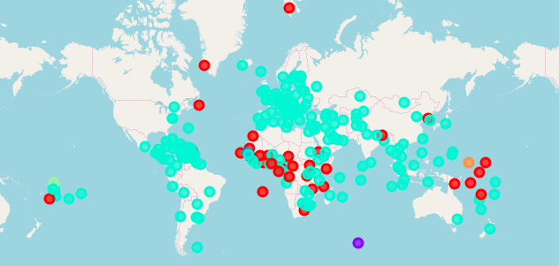

Slide 4
There are 2 main clusters
-african, middle east, south-east asia, oceania
This cluster has a hig frequency of hotels
-america, europa, southe-east asia
This cluster has a high frequency of bars and cafes

